Slide 1
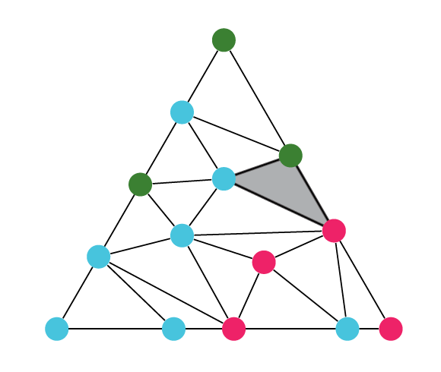
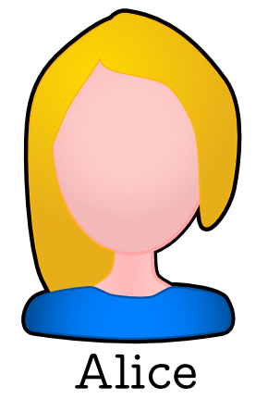
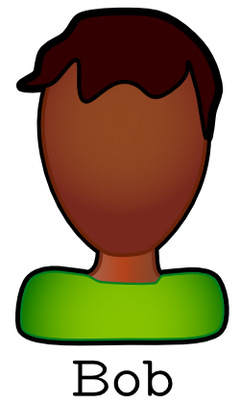
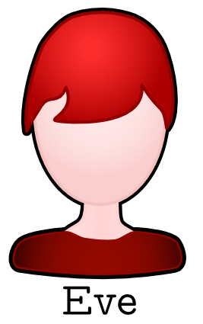
Hardness of Approximate Sperner and Applications to Envy-Free Cake Cutting
Ruiquan Gao, Mohammad Roghani, Aviad Rubinstein, and Amin Saberi
Stanford University
PPAD-complete
Sperner’s Lemma
Cake Cutting
Approximate Sperner
a natural relaxation

Slide 2
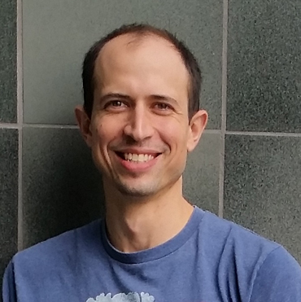
Hardness of Approximate Sperner and Applications to Envy-Free Cake-Cutting
Ruiquan Gao
Stanford University
based on joint work with
Mohammad Roghani
Aviad Rubinstein
Amin Saberi

Slide 3
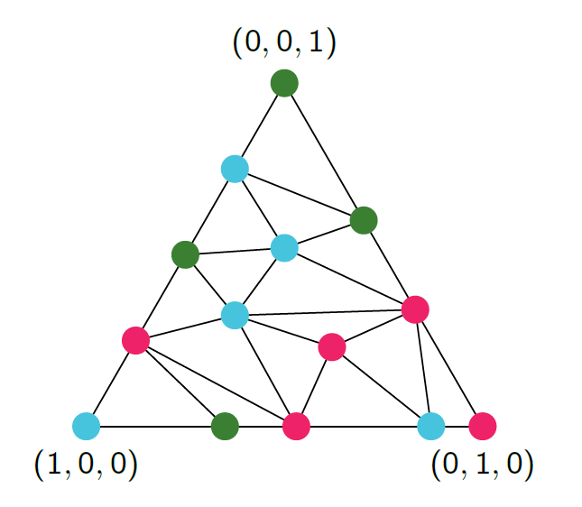
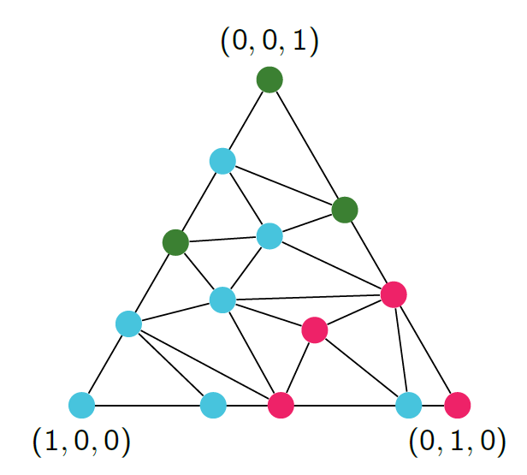
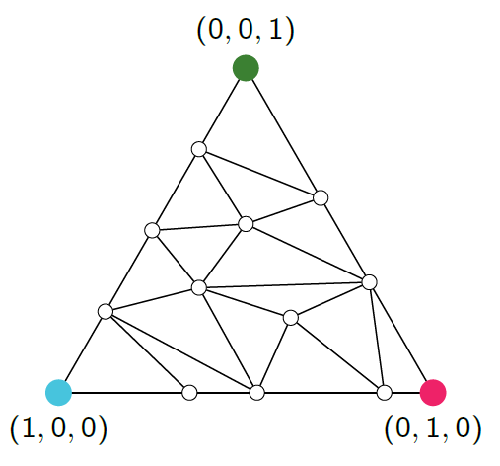
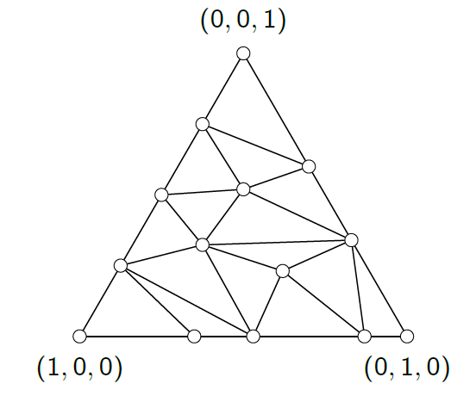
Sperner’s Lemma
Sperner’s coloring
Any triangulation of the standard $k$-simplex
Any $(k+1)$-coloring C with boundary conditions
The $k+1$ vertices are colored with $k+1$ colors
Points on each facet are colored by one of the colors on its vertices

Slide 4
Sperner’s Lemma
Sperner’s Lemma
In any sperner’s coloring, there exists a small rainbow simplex
Rainbow simplex: a simplex that contains all $k+1$colors
Applications
Combinatorial proof for Brouwer’s fixed point theorem
Other fixed point theorems (e.g., Kakutani’s)
Existence of Nash equilibrium and market equilibrium
Existence of envy-free cake-cutting
Monsky’s theorem (i.e., impossible to cut a square to equal-area triangles)

Slide 5
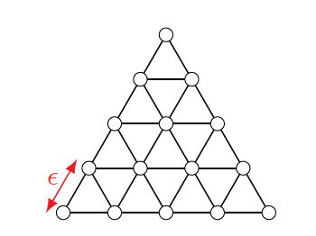
The Computational Problem of Sperner
$k$D-Sperner
Given $C$ that induces a Sperner’s coloring
Usually, we consider the Kuhn triangulation with side-length $ε=2^{−n}$
Find a small rainbow simplex in $C$
Complexity (for $k≥2)$
Computational: PPAD-complete if $C$ is a $poly(n)$-size circuit
[Papadimitriou 1994, Chen-Deng 2009]
$⟹$ Query:${ 2}^{Ω\left(n\right)}$ if $C$ is a black box

Slide 6
Envy-Free Cake-Cutting
Cake: [0,1]
$k$ cuts, $n$ agents
Allocation: partition the $k+1$pieces to the agents
Connected pieces: each agent gets one piece
General Preference Utility
$u_{i}(\vec{x},j)$: agent $i$’s utility for the $j$-th piece in cut $\vec{x}$
Additive inside the bundles
Envy-Freeness: Agent $i$ is $ε$-EF if for any other agent $j$
$$u_{i}\left(B_{i}\right)≥u_{i}\left(B_{j}\right)−ε$$
Query model: access to all $u_{i}$
Naturally, we consider the query complexity
Lipschitz: $\left|u_{i}\left(\vec{x},j\right)−u_{i}\left(\vec{y},j\right)\right|≤L⋅|\left|\vec{x}−\vec{y}\right|{\left.​\right|}_{1}$
Non-negativity: $u_{i}\left(\vec{x},j\right)>0$iff the $j$-th piece is non-empty

Slide 7
Complexity of Envy-Free Cake-Cutting
 | connected pieces | general pieces
general preference | $poly(ε^{−1})$ for $n≥3$ [Deng-Qi-Saberi 2012]
general valuations | $poly(ε^{−1})$ for $n≥4$ [Hollender-Rubinstein 2023]
additive (approx. EF) | $polylog\left(ε^{−1}\right)$ for $n≤4$[Deng-Qi-Saberi 2012, Hollender-Rubinstein 2023]
additive (exact EF, RW) | infinite for $n≥ 3$ [Stromquist 2008] | finite for any $n$ [Aziz-Mackenzie 2020]
$poly(ε^{−1})$ for $n≥3$ and $k=O(1)$ (ours)
???
$polylog(ε^{−1})$ for any $n=O(1)$
Note: for $n=2$, the divide-and-choose protocol solves all four cases in log$\left(ε^{−1}\right)$ or $O(1)$ queries

Slide 8
Complexity of Envy-Free Cake-Cutting
Technically,
$k$ cuts $⇔$ points in $k$-simplex
# $ε$-EF agents $⇔$ # colors in a size-$ε$ simplex
For general pieces: # $ε$-EF agents $=n≪$ $k+1$
Extensions
Finding an allocation in which at least $n^{′}≪n$ agents are $ε$-EF requires $poly\left(ε^{−1}\right)$ queries
We need hardness for approximate Sperner
Is finding a small simplex with $k’≪k+1$colors hard?

Slide 9
Approximate Sperner
$3$-out-of-$k+1$ Approximate Sperner
Given $C$ that induces a Sperner’s coloring
Usually, we consider the Kuhn triangulation with side-length $ε=2^{−n}$
Find a small simplex that contains at least 3 different colors
Our main result (for $k≥ 2$)
$3$-out-of-$k+1$ Approximate Sperner remains PPAD-complete for any $k<n^{0.99}$ if $C$ is a $poly(n)$-size circuit
$⟹$ Query:${ 2}^{Ω\left(n\right)}$ for any $k=O(1)$ if $C$ is a black box

Slide 10
Techniques

Slide 11
Overview
Reduction
Continuous instances
Color the entire simplex
Objective: three points that are close to each other ($≤$ side-length) and have different colors
$2$D-Sperner $≤_{p}$ $3$-out-of-$k+1$Approx. Sperner
w/ side-length $ε$ w/ side-length $ε^{O\left(k\right)}$
Next, we will focus on $k=3$

Slide 12
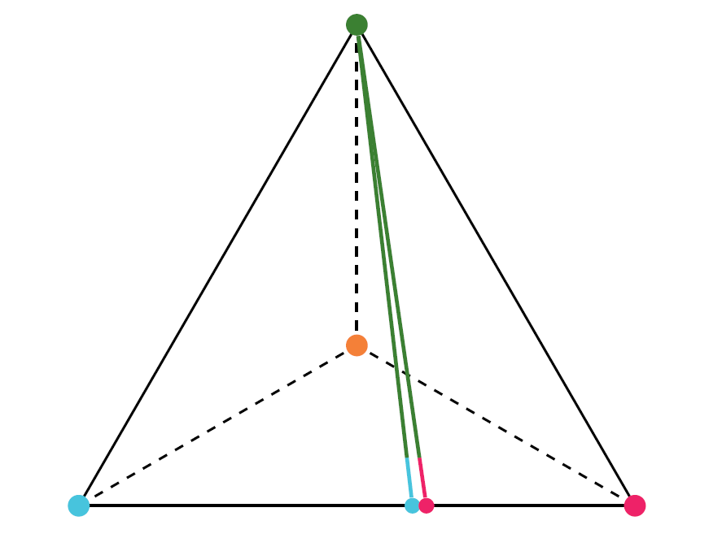
A Simple Attempt
Put the 4-th color on top of the 2D-Sperner instances
Hard to find 4 colors but easy to find 3 colors
Spurious solutions on top of the “color switches”
spurious

Slide 13
Main Idea
Put a standing copy of the 2D-Sperner on the top of the neighborhood of each “color switch”!

Slide 14
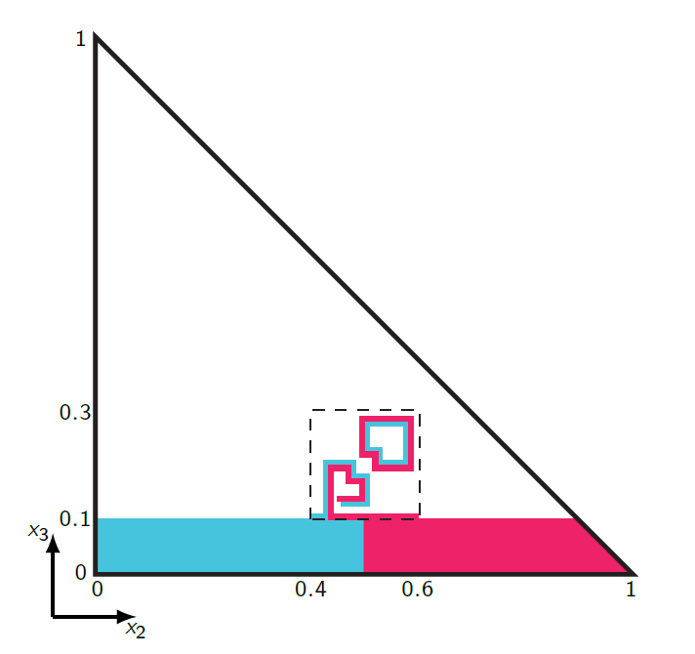
2D Instances with Good Boundaries

Slide 15
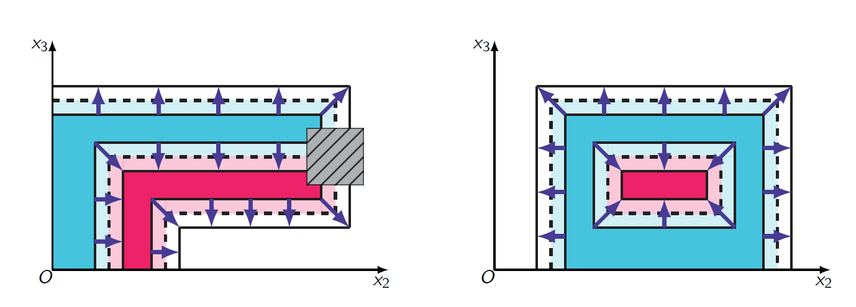
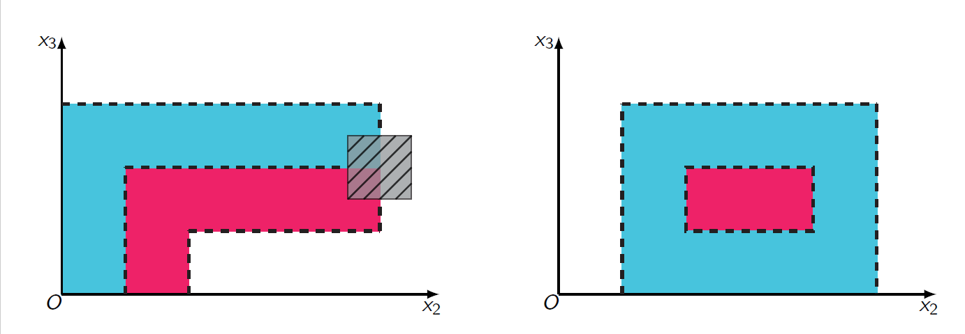
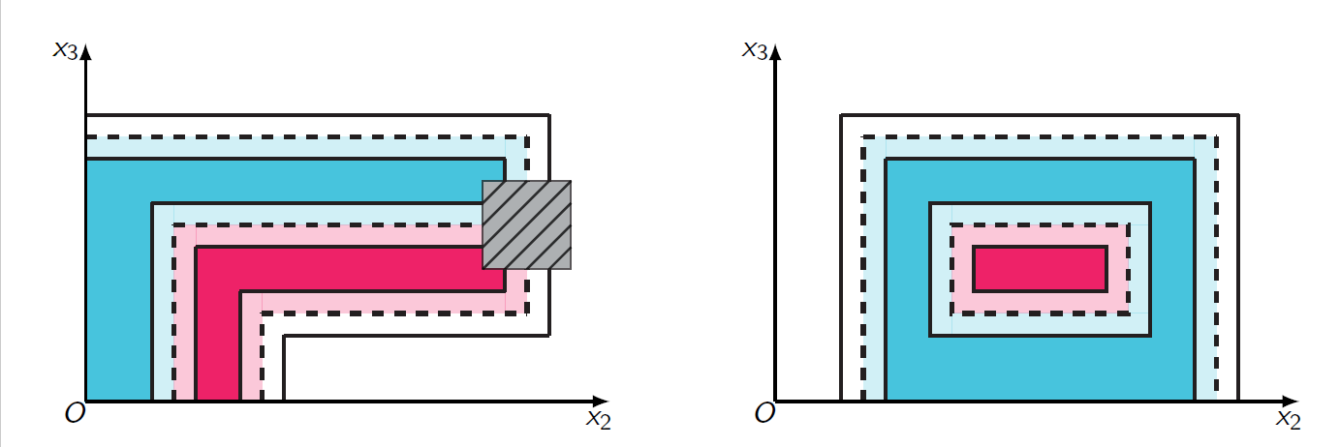
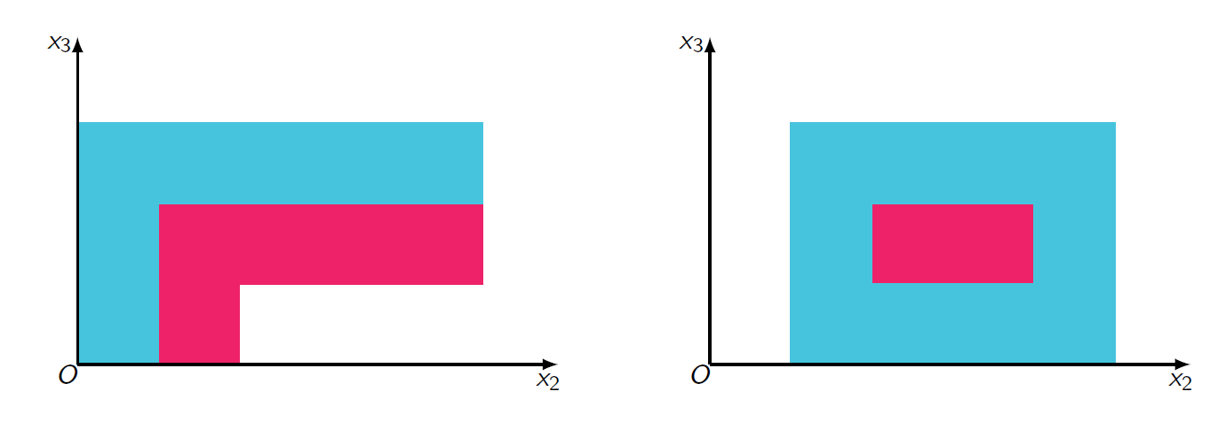
Examples

Slide 16
Conclusions

Slide 17
Conclusions
Takeaway messages
Finding a trichromatic simplex in k-dimensional Sperner is as hard as finding a rainbow one (PPAD-complete)!
Applications: envy-free cake-cutting using general pieces remains hard under general preference utility
Open Problems
Envy-free cake-cutting under general valuations
3 agents, or with general pieces
Envy-free cake-cutting under additive/monotone valuations for $≥$5 agents

