Slide 1
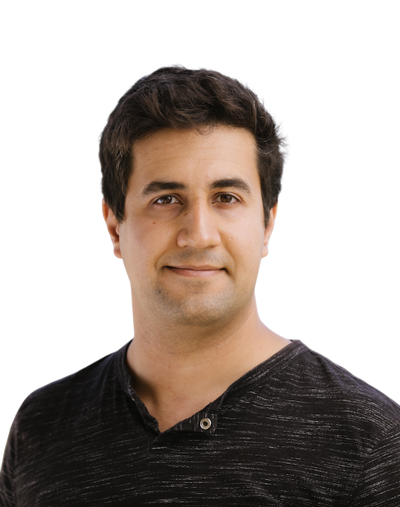
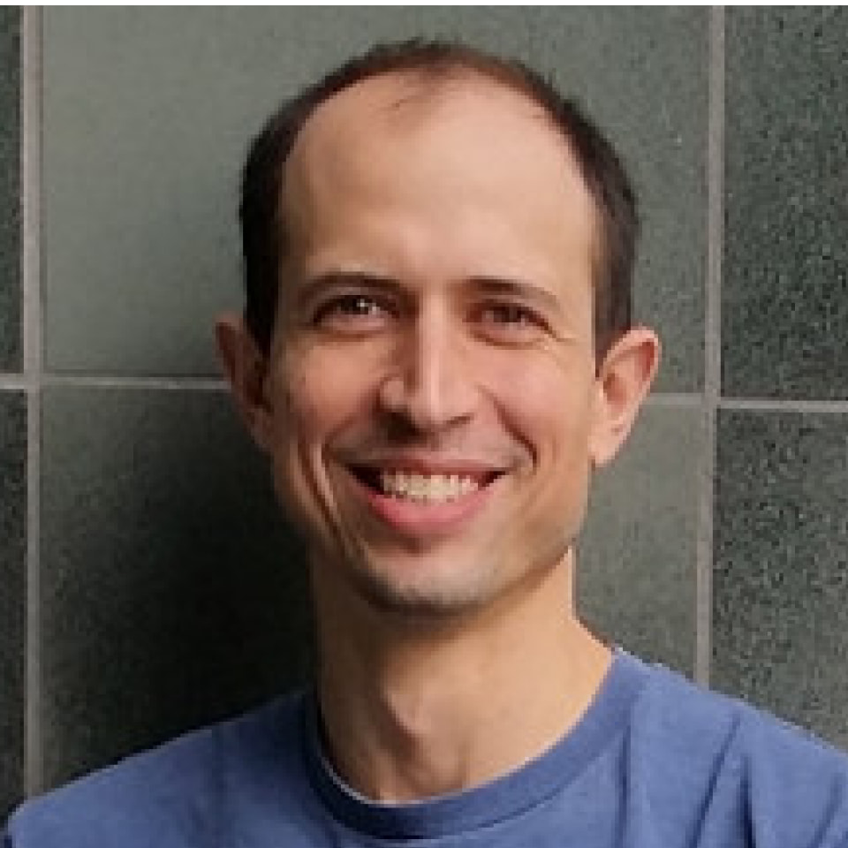
Parallel Sampling via Counting
Ruiquan Gao
Stanford University
based on joint work with
Nima Anari Aviad Rubinstein
(many parts of the slide credited to Nima Anari)

Slide 2
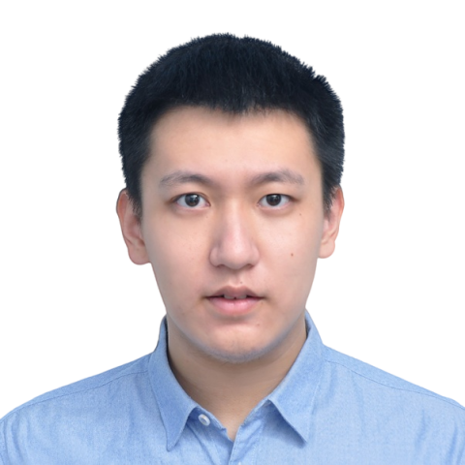
Sampling from Huge Distributions
$$f:\left(word, picture\right)↦\{0,1\}$$
Generate a random dog
$$f\left(′dog^{′}, ⋅\right)=1$$
$$f\left(′dog^{′}, ⋅\right)=0$$
$$f\left(′dog^{′}, ⋅\right)=1$$
$$f\left(′dog^{′}, ⋅\right)=0$$
$$uniform$$
$$f\left(′dog^{′}, ⋅\right)=1$$
$$f\left(′dog^{′}, ⋅\right)=0$$
$$⋮$$
$$⋮$$
(photos generated by DALL·E)

Slide 3
Counting and Sampling
Given function $f:{\left[q\right]}^{n}→[0,1]$
In the induced distribution $μ$, $Pr[x]∝f(x)$
Approximate Sampling (FPAUS):
Output random $ALG∈{\left[q\right]}^{n}$ so that $d_{TV}\left(ALG,μ\right)≤δ$ in $poly(n,\log{δ^{−1}})$ time
Fundamental result [Jerrum-Valiant-Vazirani’86]
Approximate sampling = Approximate Counting under polynomial-time Turing reduction for “self-reducible” problems
Approximate Counting (FPRAS):
Output $ALG∈[0,q^{n}]$ such that $ALG∈(1±ε)⋅\sum_{x}{f\left(x\right)}$ with probability $2/3$ in time $poly(n,ε^{−1})$

Slide 4
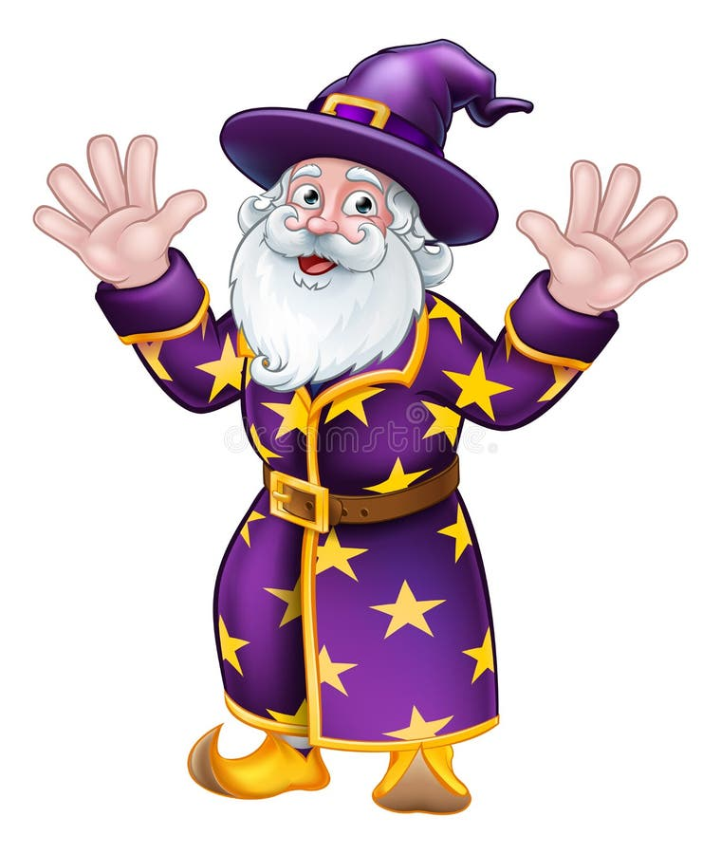
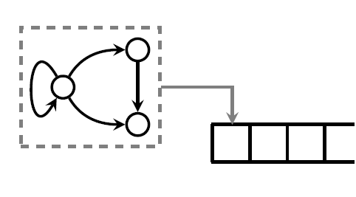
Sampling via Counting Oracles
Counting oracle
Input $S⊆\left[n\right], y_{S}∈{\left[q\right]}^{S}$
Output $\sum_{x:x_{S}=y_{S}}{f\left(x\right)}$
Conditional marginal
$μ\left(X_{i} \right| X_{S}=y_{S})$
$n$ queries (optimal)
$n$ rounds of queries
This talk
Minimize #rounds
Parallelize computation
Allow $poly\left(n\right)$ queries in total
$poly(n)$ queries
$$1,∅$$
$$σ_{1},$$
$$σ_{2},$$
$$⋯$$
$$\{μ\left(⋅|⋅\right)\}$$
$$μ(X_{1})$$
$poly(n)$ queries
$$2,\left\{1\right\}, σ_{1}$$
$$\{μ\left(⋅|⋅\right)\}$$
$$μ(X_{2}|X_{1}=σ_{1})$$
$$⋮$$
Algorithm
Oracle

Slide 5
Parallel-Efficient Counting Oracles
Determinant/Pfaffian-based counting:
Linear algebra operations are in NC [Csanky’75]
With other deterministic (approximate) counting techniques:
Correlation decay
Barvinok’s method

Slide 6
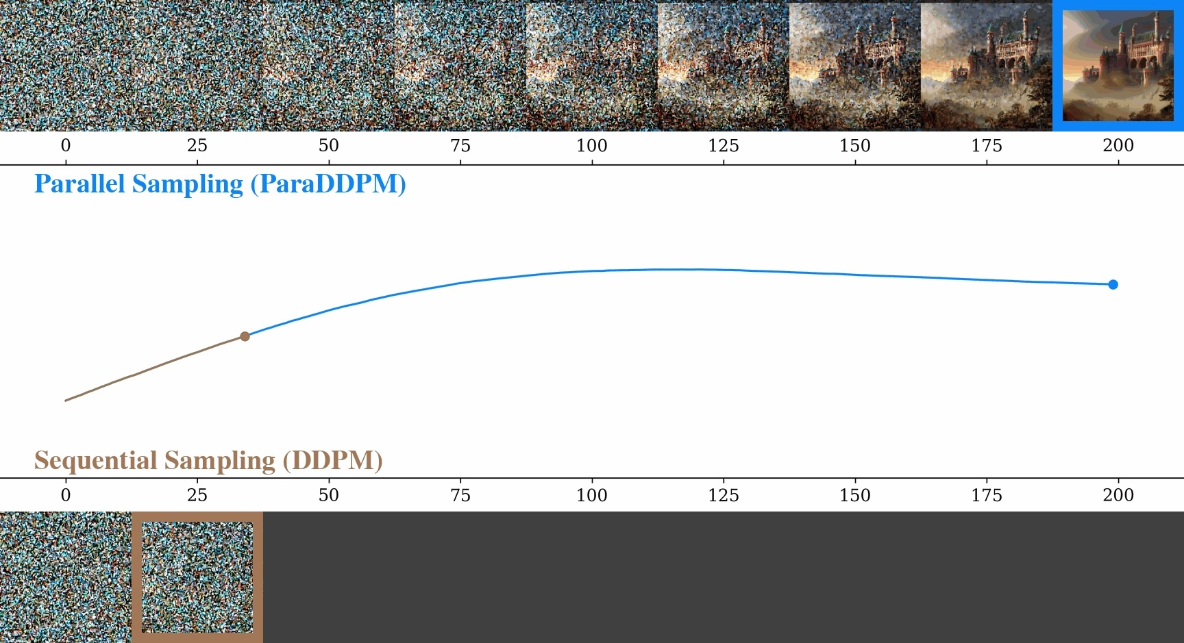
In Practice
Autoregressive model
Speculative decoding [Chen et al.’23, Leviathan-Kalman-Matias’23]
Diffusion model
Parallelized denoising diffusion [Shih et al.’23]
Any-order autoregressive model
Closely related to many popular modern neural networks [Shih-Sadigh-Ermon’22]

Slide 7
Our results
Can we have a strictly sublinear round complexity?
Yes
Exact algorithm with average round complexity $O\left(n^{2/3}⋅polylog(n,q)\right)$
$O(n)$ total queries to $μ\left(X_{i} | X_{S}\right)$ in expectation
Works with approximate counting (FPRAS) oracles
Application:
$\tilde{O}(n^{1/3})$ round complexity for sampling perfect matchings in planar graphs (previously, $\tilde{O}(n^{1/2})$)
Can we have a $polylog(n)$ round complexity?
No
$Ω({(n/\log{n})}^{1/3})$ for algorithms that make at most $n^{c}$ queries each round

Slide 8
Related Works
Parallel sampling via counting
$RNC$ algorithms for sampling spanning tree, DPP and Eulerian tours [Teng’95, Anari-Hu-Saberi-Schild’21, Anari-Huang-Liu-Vuong-Xu-Yu’23, Anari-Chewi-Vuong’24]
Quadratic speedup for sampling under entropic independence [Anari-Burgess-Tian-Vuong’23]
Parallelizing Markov chains
$RNC$ algorithms under Dobrushin-like conditions [Feng-Hayes-Yin’21, Liu-Yin’22]
$RNC$ algorithms for sampling under log-concavity and isoperimetric (log-Sobolev) inequalities [Shen-Lee’19, Anari-Chewi-Vuong’24]

Slide 9
Sublinear Upper Bound

Slide 10
Attempt 1
Goal: sample from $μ$ on ${\left[q\right]}^{n}$

Slide 11
Attempt 1
Goal: sample from $μ$ on ${\{0,1\}}^{n}$
Algorithm:
Randomly shuffle the coordinates
Fix randomness $u_{1},u_{2},…, u_{n}$ for $X_{1},…,X_{n}$ respectively
On each round $t$,
$∀i$, $p_{i}^{\left(t\right)}←μ\left(X_{i} \right| X_{1:i−1}=σ_{1:i−1}^{\left(t−1\right)})$
$∀i$, $σ_{i}^{\left(t\right)}←Sampler(p_{i}^{\left(t\right)},u_{i})$
$∀i$, $q_{i}^{\left(t\right)}←μ\left(X_{i} \right| X_{1:i−1}=σ_{1:i−1}^{\left(t\right)})$
$∀i$, $z_{i}^{\left(t\right)}←Sampler(q_{i}^{\left(t\right)},u_{i})$
Terminate if $σ^{\left(t\right)}=z^{\left(t\right)}$
Terminate in $\tilde{Θ}(n)$ rounds
Incorrect conditioning for $X_{i}⟹$ Incorrect $σ_{i}^{\left(t\right)}$
$$t$$
$$t+1$$
new samples
We want to compute: $σ^{∗}∈\{{0,1\}}^{n}$s.t.
$$σ_{i}^{∗}=Sampler(μ\left(X_{i} | X_{1}=σ_{1}^{∗},…,X_{i−1}=σ_{i−1}^{∗}\right), u_{i})$$
verification
For $q=2$: $Sampler\left(Ber\left(p\right), u\right)=$
$$1(u>1−p)$$

Slide 12
Attempt 2 – Our algorithm
Goal: sample from $μ$ on ${\{0,1\}}^{n}$
Algorithm:
Randomly shuffle the coordinates
Fix randomness $u_{1},u_{2},…, u_{n}$ for $X_{1},…,X_{n}$ respectively
On each round $t$,
$∀i$, $p_{i}^{\left(t\right)}←μ\left(X_{i} \right| X_{1:i−1}=σ_{1:i−1}^{\left(t−1\right)})$
$∀i$, $σ_{i}^{\left(t\right)}←Sampler(p_{i}^{\left(t\right)}, u_{i})$
$∀i$, $q_{i}^{\left(t\right)}←μ\left(X_{i} \right| X_{1:i−1}=σ_{1:i−1}^{\left(t\right)})$
$∀i$, $z_{i}^{\left(t\right)}←Sampler(q_{i}^{\left(t\right)}, u_{i})$
Terminate if $σ^{\left(t\right)}=z^{\left(t\right)}$
$p_{i}^{\left(t\right)}←μ\left(X_{i} \right| X_{1:m}=σ_{1:m}^{\left(t−1\right)})$, where
$m≔$ len(the longest correct prefix of $σ^{\left(t−1\right)}$)
$:=\min{ \left\{i:σ_{i}^{\left(t−1\right)}≠σ_{i}^{∗}\right\}−1}$
$=\min{ \left\{i:σ_{i}^{\left(t−1\right)}≠z_{i}^{\left(t−1\right)}\right\}} −1$
new samples
verification
We want to compute: $σ^{∗}∈\{{0,1\}}^{n}$s.t.
$$σ_{i}^{∗}=Sampler(μ\left(X_{i} | X_{1}=σ_{1}^{∗},…,X_{i−1}=σ_{i−1}^{∗}\right), u_{i})$$

Slide 13
Attempt 2 – Our algorithm
Pinning Lemma (informal): random conditioning ⟹ low correlation between the unconditioned variables
$$E_{\left|S\right|}E_{i,j, S}E_{X∼μ}\left[Cov{\left(X_{i},X_{j} | X_{S}\right)}^{2}\right] ∼\frac{1}{n}$$
$⟹$ Proceed by $n^{Ω\left(1\right)}$ w.p. $Ω(1)$
Goal: sample from $μ$ on ${\{0,1\}}^{n}$
Algorithm:
Randomly shuffle the coordinates
Fix randomness $u_{1},u_{2},…, u_{n}$ for $X_{1},…,X_{n}$ respectively
On each round $t$,
$∀i$, $p_{i}^{\left(t\right)}←μ\left(X_{i} \right| X_{1:m}=σ_{1:m}^{\left(t−1\right)})$
$∀i$, $σ_{i}^{\left(t\right)}←Sampler(p_{i}^{\left(t\right)}, u_{i})$
$∀i$, $q_{i}^{\left(t\right)}←μ\left(X_{i} \right| X_{1:i−1}=σ_{1:i−1}^{\left(t\right)})$
$∀i$, $z_{i}^{\left(t\right)}←Sampler(q_{i}^{\left(t\right)}, u_{i})$
Terminate if $σ^{\left(t\right)}=z^{\left(t\right)}$
Small neural networks
where$m≔$ len(the longest correct prefix of $σ^{\left(t−1\right)}$)
$=\min{ \{i:z_{i}^{\left(t−1\right)}≠σ_{i}^{\left(t−1\right)}\}} −1$
new samples
Trained large neural networks
verification
Fun Fact: a similar-looking algorithm, speculative decoding, has been considered by practical AI researchers

Slide 14
Round Complexity
Suppose
Small-progress round: $m$ increases by at most $θ$
Let $p_{i|j}=\operatorname{Pr}\left[X_{i}=0 \right| X_{1},…,X_{j}]$(form a martingale w.r.t. $j$)
By Doob’s martingale inequality,
$$i$$
$$p_{i|j}$$
Max prob. $σ_{i}^{\left(t\right)}$ is the 1st incorrect var.
Prob. $σ_{i}^{\left(t\right)}$ is incorrect
$$j$$
$$i−θ$$
$$i−1$$
$$E\left[\#small\text{−}progress\right]≤\sum_{i∈\left[n\right]}{2⋅E\left[\max_{j∈\left[θ\right]}\left|p_{i|i−j}−p_{i|i−1}\right|\right]}$$
$≤\sum_{i∈\left[n\right]}{O(\log{n)}⋅E[|p_{i|i−θ}−p_{i|i−1}|]}$

Slide 15
Pinning Lemma
Introduced by [Montanari’08, Raghavendra-Tan’12]
Randomly conditioning (pinning) on some variables $⟹$ low correlation between the remaining variables
Our New Variant
Let $μ_{i|j}\left(σ\right)=\operatorname{Pr}\left[X_{i}=σ | X_{1:j}\right]$, coordinates be randomly permuted,
$$\sum_{i}{E\left[d_{TV}{\left(μ_{i|i−θ}, { μ}_{i|i−1}\right)}^{2}\right]}≤O(θ\log{q})$$
Under $ℓ_{1}$-norm: $\sum_{i}{E\left[d_{TV}\left(μ_{i|i−θ}, { μ}_{i|i−1}\right)\right]}≤O(\sqrt{nθ\log{q}})$
If $θ=Θ(n^{1/3})$, the number of small-progress rounds is $\tilde{O}(n^{2/3})$

Slide 16
Putting Everything Together
In total
Small-progress: $\tilde{O}(n^{2/3})$ when $θ∼n^{1/3}$
Large-progress: $n/θ$
Taking $θ∼n^{1/3}$, total round complexity $≤$ $\tilde{O}(n^{2/3})$

Slide 17
Sampler for $q>2$
Universal Coupling [Liu-Yin’22]
Construct a function $f:Δ\left(\left[q\right]\right)×\left[0,1\right]→\left[q\right]$
Couple distributions $\{μ_{i}\}_{i∈\left[k\right]}$ by $\{f\left(μ_{i},r\right)\}_{i∈\left[k\right]}$ where $r∼uniform(\left[0,1\right])$
Two distributions [Liu-Yin’22]
$\underset{r∼\left[0,1\right]}{Pr}\left[f\left(μ, r\right)≠f\left(υ,r\right)\right]≤2⋅d_{TV}(μ, υ)$
Multiple distributions:
$\underset{r∼\left[0,1\right]}{Pr}\left[∃i,j, f\left(μ_{i}, r\right)≠f\left(μ_{j},r\right)\right]≤O\left(\log{kq}\right)⋅E[d_{TV}\left(μ_{1}, μ_{k}\right)]$
if $μ_{1}(j),…,μ_{k}\left(j\right)$ form a martingale for each $j∈\left[q\right]$
A more practical implementation:
Take ${argmin}_{j} u_{j}/μ(j)$, where $u_{j}∼Exp⁡(1)$
This is a martingale:
$\operatorname{Pr}\left[X_{i}=j \right| X_{1},…,X_{m}]$
$\operatorname{Pr}\left[X_{i}=j \right| X_{1},…,X_{m+1}]$
$⋮$
$\operatorname{Pr}\left[X_{i}=j \right| X_{1},…,X_{i−1}]$

Slide 18
Polynomial Lower Bound

Slide 19
Construction Overview
$\sim n^{2/3}$coordinates
$\sim n^{2/3}$coordinates
$\sim n^{2/3}$coordinates
Key property
For any query: having a non-zero probability mass in Block $i$ $⟹$ with high probability, having a fixed probability mass in Blocks $≥i+1$
Before we know something (with constant probability) about Block $i$, we can know (almost) nothing about all subsequent blocks
$$C_{1}=\{x:A_{1}x=b_{1}\}$$
$$C_{2}=\{x:A_{2}x=b_{2}\}$$
$$C_{r}=\{x:A_{r}x=b_{r}\}$$
under $𝔽_{2}$, where
$$\dim\left(C_{1}\right)∼n^{1/3}$$
under $𝔽_{2}$, where
$$\dim\left(C_{2}\right)∼2⋅n^{1/3}$$
$$⋯$$
under $𝔽_{2}$, where
$$\dim\left(C_{r}\right)∼r⋅n^{1/3}$$
$$μ =$$
$$μ_{1}=uniform(C_{1})$$
$$×$$
$$μ_{2}=uniform(C_{2})$$
$$×$$
$$⋯$$
$$×$$
$$μ_{r}=uniform(C_{r})$$
Block $1$
Block $2$
Block $r$
$$r∼n^{1/3}$$

Slide 20
Conclusions

Slide 21
Open Problems
Parallel reduction of sampling to counting with polynomial speedups.
And, a polynomial speedup is the best we have in general
Planar perfect matchings in $polylog⁡(n)$time?
Close the gap between $n^{2/3}$ and $n^{1/3}$.
Analysis of the algorithm is tight, so the algorithm has to change.
Potential change: add in Picard-like iterations.

Slide 22
Thank you!
Questions are welcomed!

